Slide 1
California’s Hub and Spoke System
Learning Collaborative 4
Hub and Spoke: Building a System of Care
Richard Rawson, PhD
Professor Emeritus, UCLA
Christopher Lukonis, MD, PhD
Gifford Health Care, Vermont
Mark MdGovern & Mehret Assefa, MPH, PhD
Stanford University School of Medicine
June 18th, 2018 and June 28th, 2018
(repeated)
*Content was edited for publication.*

Slide 2
Agenda
Introductions and overview – Rick Rawson
Circulation Through the Hub and Spoke – Chris Lukonis
Practice Discussion
Prescriber Facilitator project – Rick Rawson
QI Measures – Mehret Assefa/Mark McGovern

Slide 3
The Hub and Spoke System: A Public Health Response to the Opioid Epidemic in California
Historically, the treatment of substance use disorders in California has been a collection of community tradition, self-help and evidence-based activities, delivered in specialty care settings, with minimal involvement of medical professionals.
The hub and spoke (H&S) model of services in a large scale implementation of MAT for treatment of individuals with opioid use disorders TO REDUCE OVERDOSE DEATHS, reduce opioid and other drug use and infectious diseases; reduce ED admissions and drug-related crime and criminal justice involvement; and to improve functioning.

Slide 4
The Hub and Spoke System: A Public Health Response to the Opioid Epidemic in California
The implementation of the H&S model in California is the first time California has addressed opioid addiction as a major public health crisis.
The specialty care system is entirely inadequate to provide adequate access to MAT, the only evidence-based treatment for OUD.
The key to expanding access to MAT is to DRAMATICALLY EXPAND MAT IN PRIMARY CARE SETTINGS

Slide 5
The Hub and Spoke System: A Public Health Response to the Opioid Epidemic in California
As fentanyl has become a common component of heroin sold in the US, the lethality of injection opioid use has increased exponentially.
The overarching purpose of the H&S is to dramatically expand access to MAT in California. Expanded MAT will REDUCE OVERDOSE DEATHS.
MAT access can only be scaled up commensurate with the public health need in California by:
Increasing the number of waivered prescribers
Increasing the number of waivered prescribers who actively prescribe buprenorphine.
Increasing the number of individuals treated by each waivered prescriber.

Slide 6
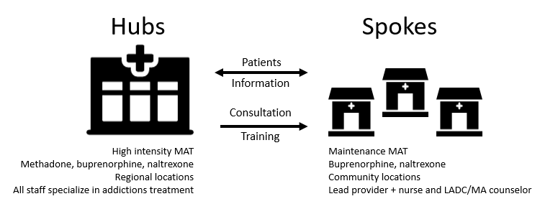
Circulation Through the
Hub and Spoke
Christopher J. Lukonis, M.D., Ph.D.

Slide 7
Disclaimer
I am here to describe my experience in Vermont.
Each state has different rules and regulations around MAT and funding source utilization expectations.
When in doubt, bounce your ideas off your administrators.

Slide 8
Objectives
Why embrace the least restrictive level of care?
Review approaches and philosophies that may facilitate movement through the Hub and Spoke system
Describe the role of the MAT team

Slide 9
Levels of Care
Methadone→ buprenorphine→ naltrexone
One size does not fit all
Convenience for patients→ integration back into the community
  Work
  School
  Family
Long-term costs for society

Slide 10
Healthy Flow
Patients needing daily observed dosing are admitted to the Hub
As patients are stabilized they are transferred to less restrictive levels of care
  Take Homes
  Spokes (if on buprenorphine)
Patients unstable in the Spoke are readily transferred back up to the Hub

Slide 11
Aids to Flow
Consider buprenorphine first-line
Early buprenorphine take home doses
Double/double/triple dosing
Priority admission for unstable Spoke patients
  Don’t reinvent the wheel, get them in
Engage Hub counselors with the MAT team to make efficient Spoke transfers

Slide 12
Aids to Flow
Have MAT team screen Hub waiting lists for Spoke candidates
Regular MAT Team/Hub counselor meetings to review transfers (both directions)
Avoid the “black hole” Spoke to Hub transfer

Slide 13
Rapid Access Treatment in the ED
Screen patient for OUD in the ED
Initiate buprenorphine in the ED or do home induction (3 day maximum prescription)
Refer to a Hub or Spoke to be seen within 72 hours
JAMA. 2015;313(16):1636-1644. doi:10.1001/jama.2015.3474

Slide 14
Example: Baseline Criteria for
Spoke Transfer from Hub
On at least 6 take homes per week
Successful medication call-back
Screen for EtG and THC
Recommendation from counselor
Meeting with Medical Director

Slide 15
Possible MAT Team Functions
Triage waiting lists
Help define Spoke level of care on continuum: Spoke, Super-Spoke, etc.
ED-BRIDGE

Slide 16

MAT team fine-tuning of referral
Matching patient to prescriber preferences and expertise
  Specialty
  Geographic considerations
  Handling marijuana use
  Use of other illicit substances, EtOH
  Comfort level with mental health disorders
  Pregnancy
  Pain management

Slide 17
Spoke Styles Examples
Busy PCP office
  Already on stable dose of buprenorphine
  Stable for monthly follow-up
  Stable mental health disorders
Group psychiatry practice
  Time for buprenorphine induction
  Easy access to augmented mental health care, such as IOP
  Follow-up available multiple times per week

Slide 18
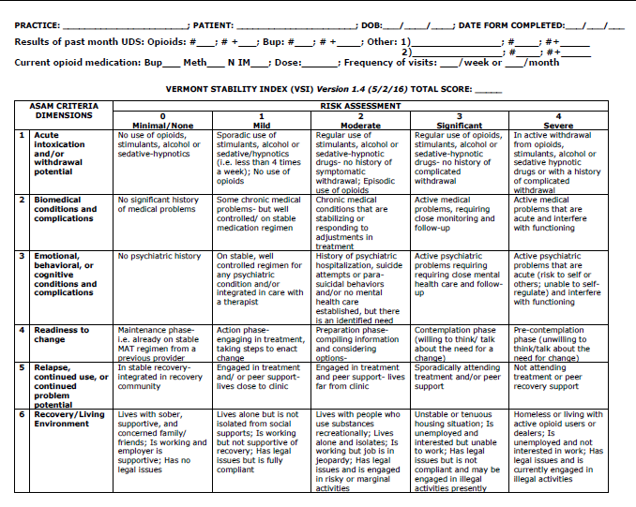
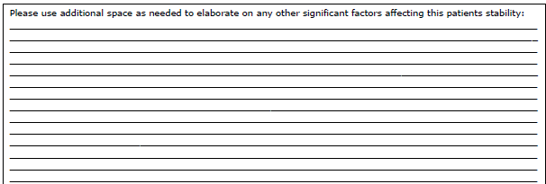

Slide 19
Hub: How to connect to Spokes?
Multi-site MAT teams
Pharmaceutical representatives
House-calls
Open houses

Slide 20
Connecting Hub to Spoke
Devote part of Hub physician time to networking
Make Hub consultation an option
Assure rapid access to Hub for unstable spoke patients
  Spoke to Hub “72 hour rule” courtesy dose

Slide 21

Additional MAT team referral functions
“Warm hand-offs”
  Patients who meet baseline criteria must generally be referred to a Spoke
  Smooth transition into Hub or into Spoke
Updates on transfers to referring providers

Slide 22
Referral to the Hub
Not punishment
It is a referral to a specialist
Explore patient perception
Set concrete goals for return to Spoke (preferably written, definitely communicated to Hub)
Continue other medical/psychiatric care if possible

Slide 23
Keys to Flow
Close, working relationship between Hub physician and Spoke prescribers
Strong MAT teams:
  Willing to share expertise with prescribers
  Induction assistance
Prescribers willing to take measured risks with Hub physician support

Slide 24
SPOKE
SPOKE
HUB
SPOKE
SPOKE
HUB

Slide 25
Practice Discussion
How are you managing patient flow in the Hub and Spoke?
What procedures and guidelines are in place?
What questions do you have on how to improve your systems of care?
What is the flow in ED-BRIDGE sites? How is it different than Hub to Spoke or vice versa

Slide 26
PRESCRIBER FACILITATION: SCALING UP
ADDICTION MEDICATIONS
IN THE CALIFORNIA
HUB & SPOKE INITIATIVE

Slide 27
CALIFORNIA HUB & SPOKE INITIATIVE
21st Century Cures Act funds to states to combat opioid epidemic—California received largest amount over 2-year timeframe
CA strategy is to adapt Vermont regional Hub (NTP/OTP) and Spoke (OBOT) model
19 regional Hubs have been funded---growth in patient numbers for MAT
Spokes (OBOTs) associated with Hubs—minimal growth in MAT patient numbers
In year 2, adjusted focus on supporting Hubs to accelerate Spoke capacity
Practice Facilitation---deploying experts (MD and other professionals) with Hub MAT coordinators to new and existing Spoke practices in the network

Slide 28
EXPERT PRESCRIBER FACILITATION
Experts contract directly with NTP Hub organization
Independent consultant (contractor) status: ~ 10 hours month; Hourly rate TBN
9 months
No direct patient care
Minimal onsite, primarily tele- and video-conferencing with Spoke providers and teams
Focus of consultation will vary based on stage of implementation and needs of Spoke providers and teams

Slide 29
SUPPORT FOR FACILITATION TEAMS
Dr. Mark McGovern coordinates this initiative—facilitates quarterly teleconference meetings among all 19 facilitation teams
Troubleshooting with individual teams as needed
Dr. Karen Oliver (U Wisconsin Medical School), VA and AAAP expert in Practice Facilitation, provides initial training (webinar) and attends quarterly teleconference meetings
Opportunities to attend other CA Hub and Spoke System events: Regional learning collaborative sessions, state steering committee meetings, CME webinars

Slide 30
QI MEASURES

Slide 31
Aegis-Roseville
ROSEVILLE, CA
Presenter: Sarah Khawaja, Grant Hub Manager
*Content was edited for publication.*

Slide 32
Acadia Healthcare
San Diego
SAN DIEGO, CA
Presenter: Debbie Hamilton, Hub Coordinator
*Content was edited for publication.*

Slide 33
Matrix Institute on Addictions
LOS ANGELES, CA
Presenter: Shawn McLendon, H&SS Project Coordinator
*Content was edited for publication.*

Slide 34
BAART Programs
San Francisco
San Francisco, CA
Presenter: Christopher Martinez, H&SS Project Coordinator
*Content was edited for publication.*

Slide 35
Tarzana Treatment Center, Inc.
TARZANA, CA
Presenter: Christine Erinakis, Hub Data Evaluator
*Content was edited for publication.*

Slide 36
Janus of Santa Cruz
South
SANTA CRUZ, CA
Presenter: Robin Oakeu, Project Coordinator
*Content was edited for publication.*

Slide 37
Next Steps
Connect with or refer a facilitator in your region
Connect with local ED
Participate in training events

Slide 38
Upcoming Events
California Department of Health Care Services: Substance Use Disorder Statewide Conference
  August 21st-23rd
California Society of Addiction Medicine: The State of the Art in Addiction Medicine
  August 29th-September 1st
Statewide MAT Webinar: Focus on Stigma
  September 6th (registration coming soon)
The Science and Practice of Treating Patients With Pain & Opioid Use Disorder (OUD)
  September 18th
  September 26th
  3rd Date TBD
California Primary Care Association Annual Conference
  October 4th & 5th
15th Annual Integrated Care Conference
  October 24th & 25th

Slide 39
Contact Us
Rick Rawson
rrawson@mednet.ucla.edu
Mark McGovern
mpmcg@stanford.edu
Cell: (603) 381-1160
CA Hub and Spoke Website and Listserv
http://uclaisap.org/ca-hubandspoke
Email kimberlyvalencia@mednet.ucla.edu to receive Listserv updates

